Slide 1

AssetWizzards
Asset
Management:

Slide 2

Introduction to Asset Management
E-Asset Management System is a powerful solution designed to revolutionize asset management and tracking .
Efficiently managing a range of assets.
Help Borrowers for their undisrupted flow of work.

Slide 3



Problem Statement
Current asset management practices are inefficient and error-prone, leading to suboptimal resource utilization and increased operational costs. Our project aims to develop a web-based E-Asset Management System to streamline tracking, enhance accountability, and optimize asset management processes.

Slide 4
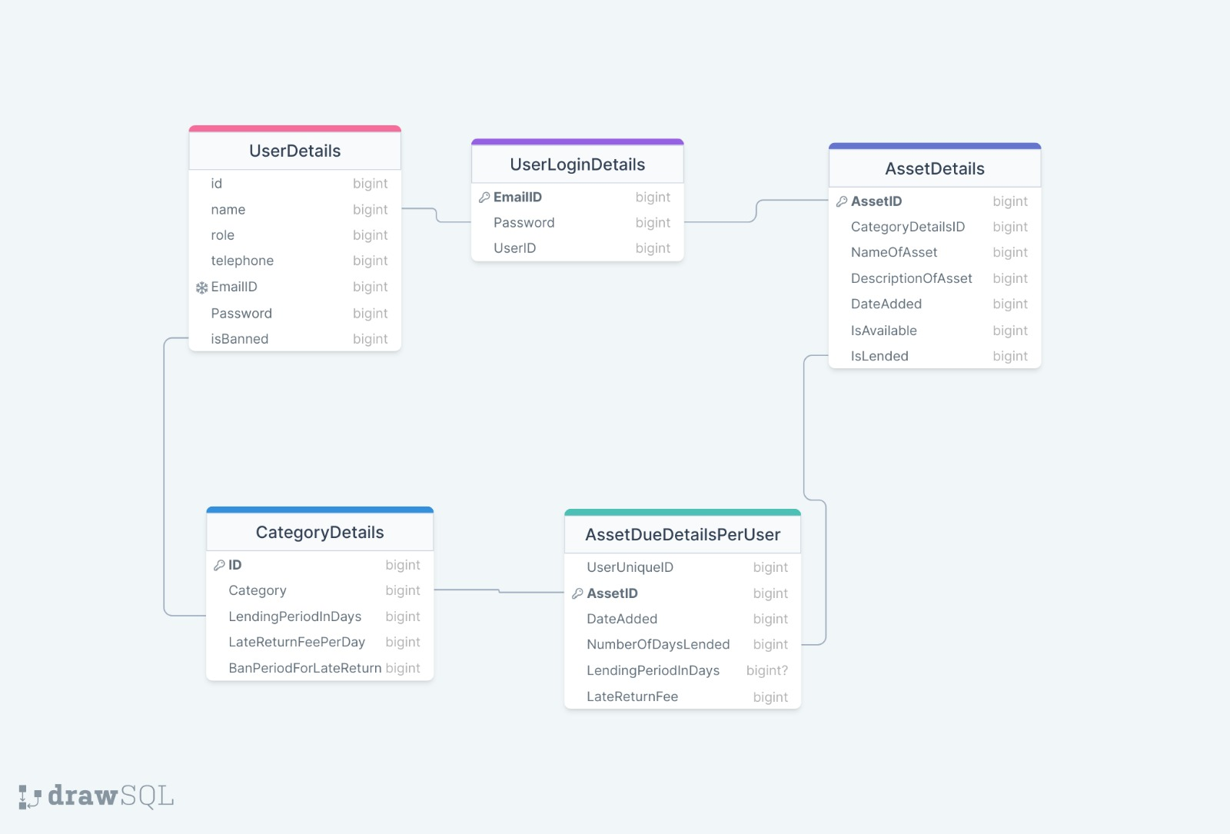
ER Diagram of the System

Slide 5

Work Flow
Firstly, User Page will appear
There are two types of Users:
Admin
Borrower
Login by entering the Credentials
Admin is already Registered and If Borrower doesn't exist then Register first
Landing Page appears

Slide 6
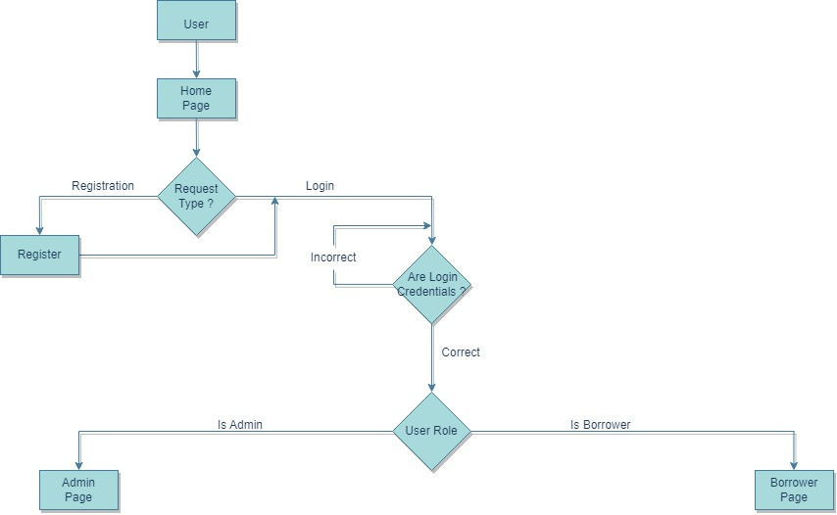
User's Page

Slide 7
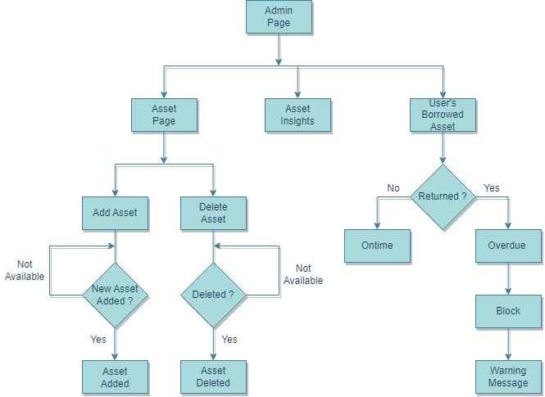
Admin's Page

Slide 8
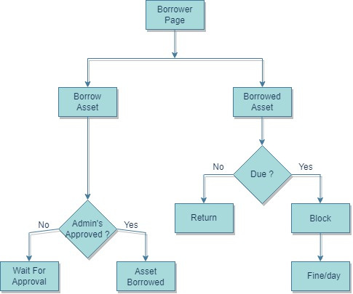
Borrower’s Page

Slide 9

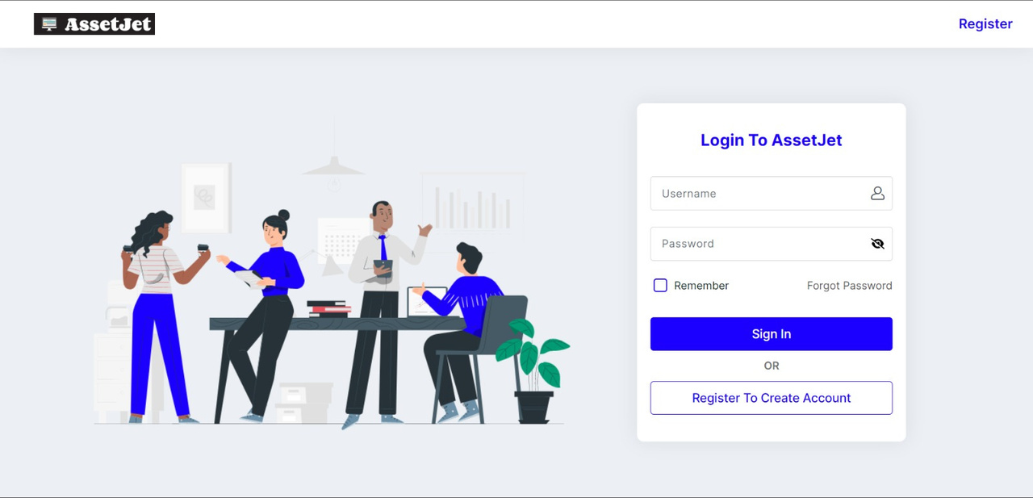
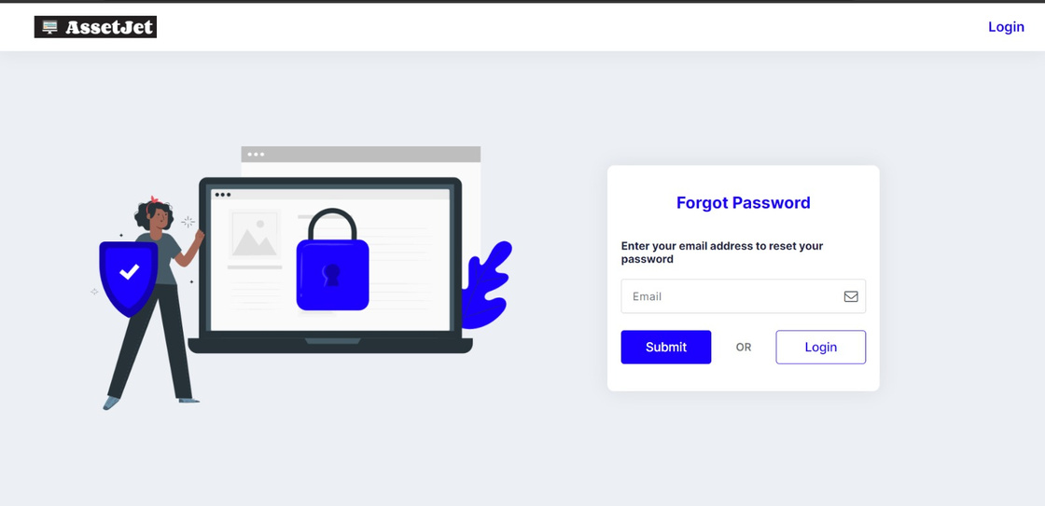
Login Page
If user forgets password

Slide 10
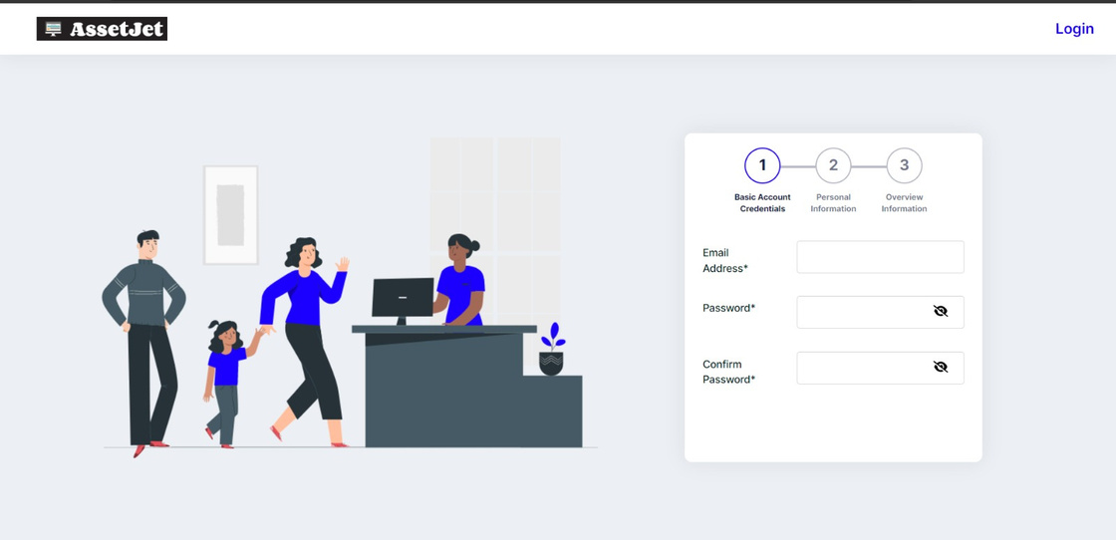
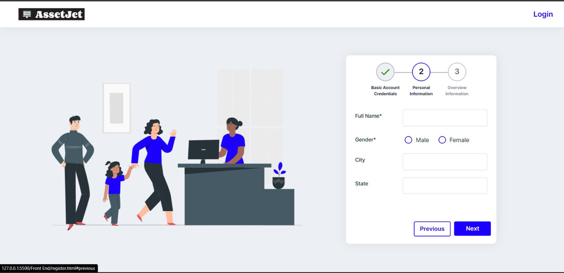

Slide 11


Slide 12
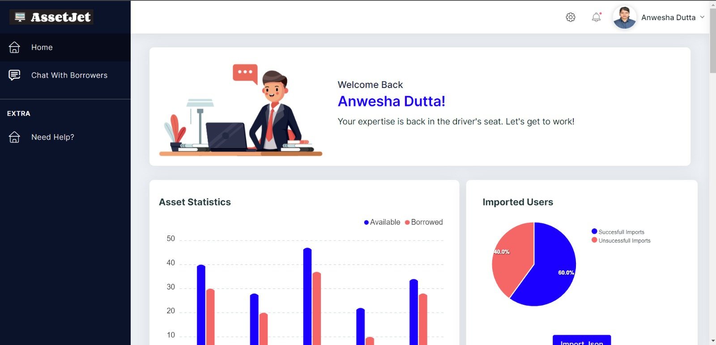
Admin's Portal

Slide 13
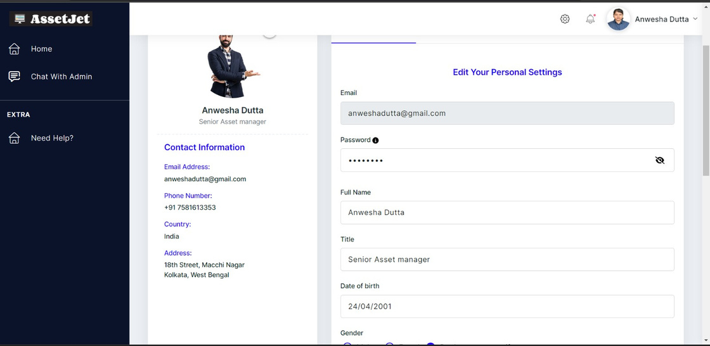
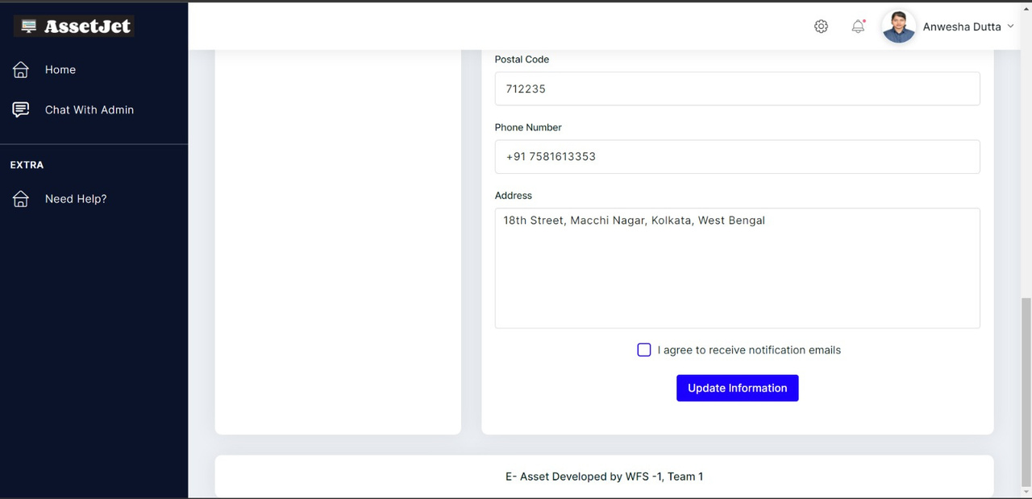
Updating Information Section

Slide 14
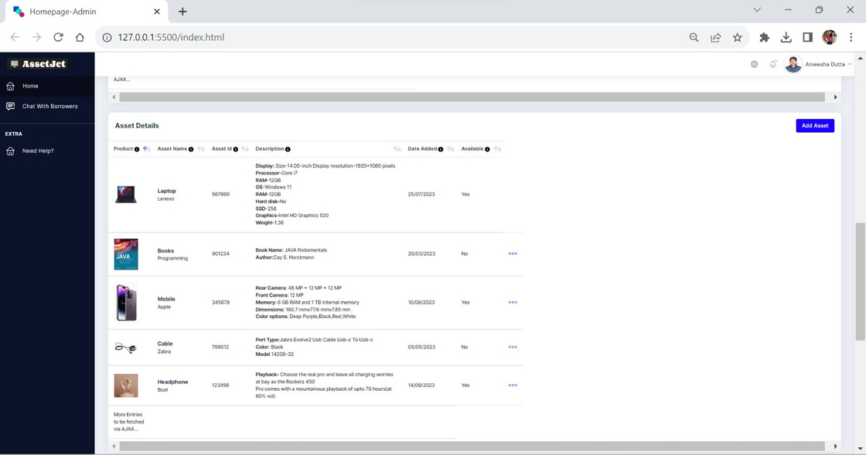
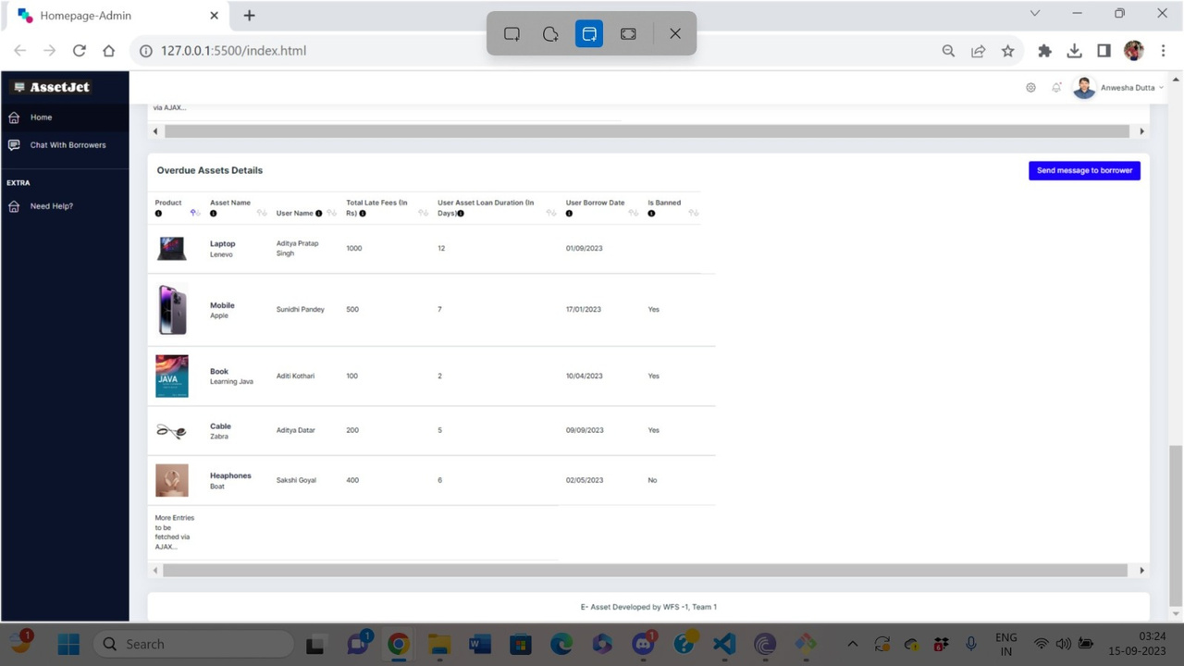

Slide 15
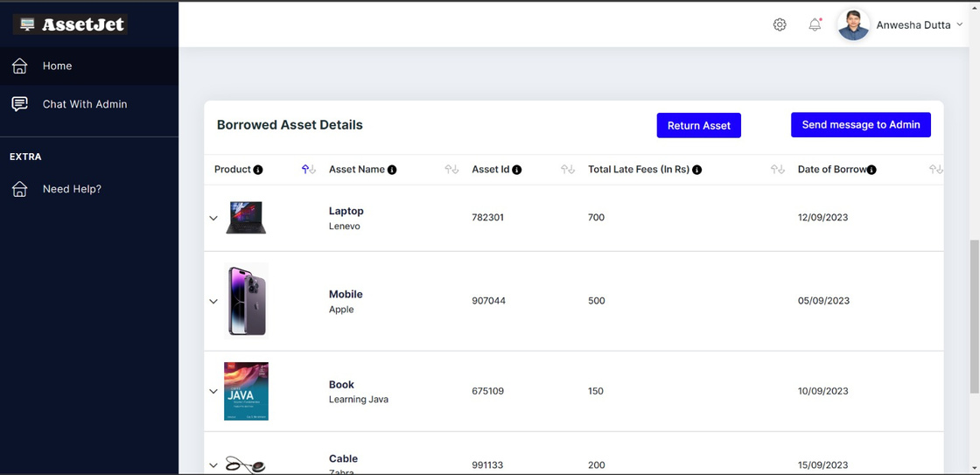
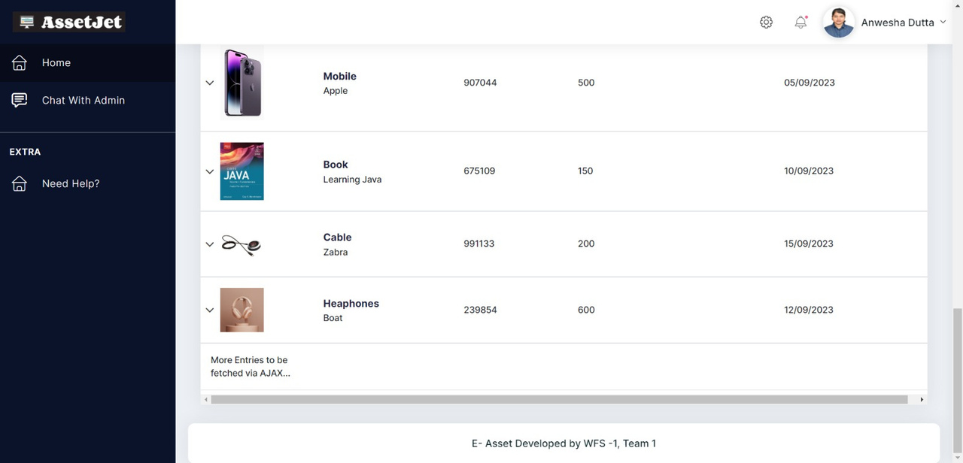

Slide 16
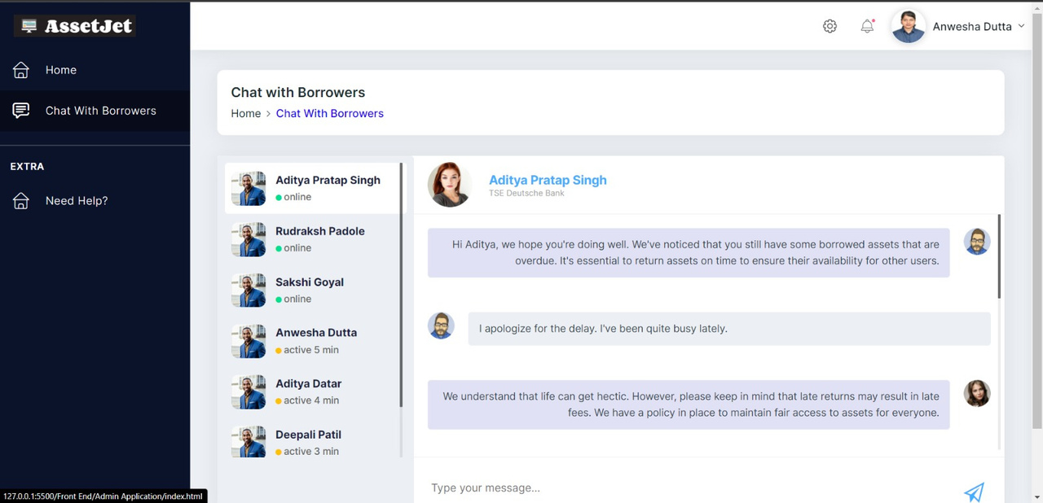
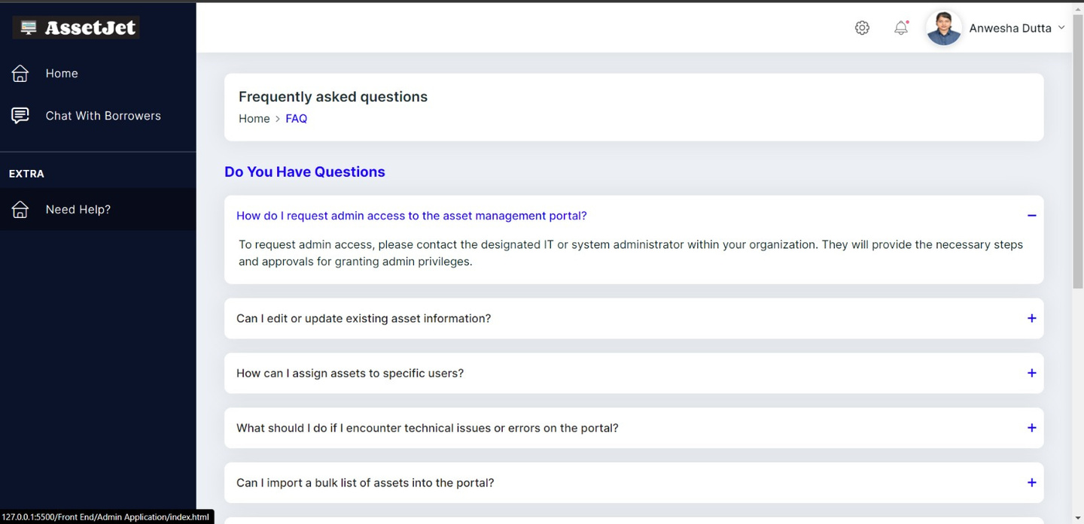
Chat with Borrowers
FAQs

Slide 17
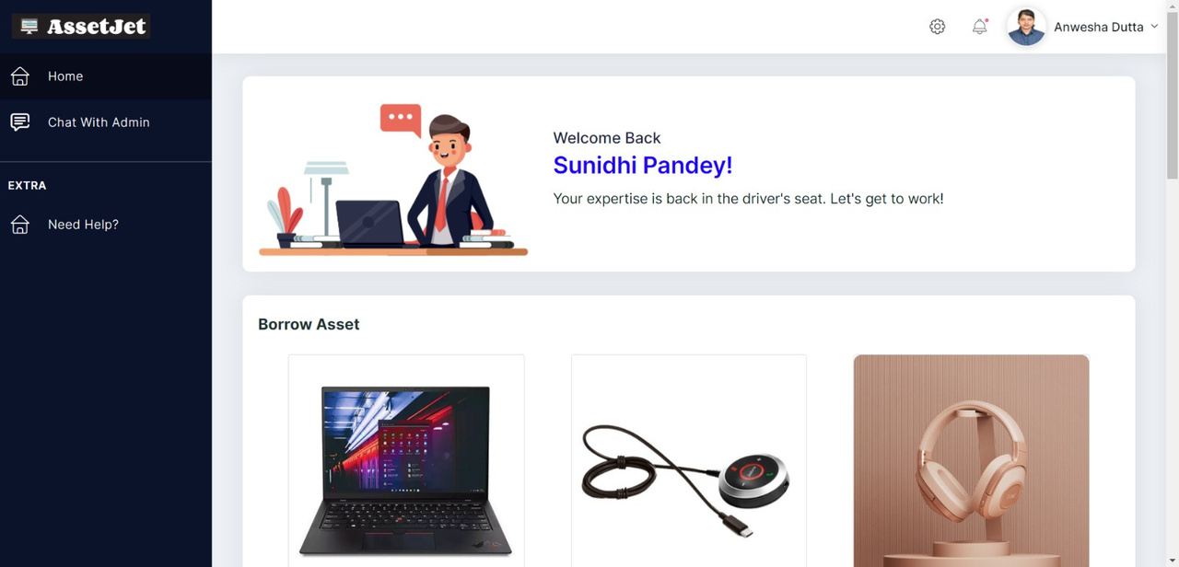
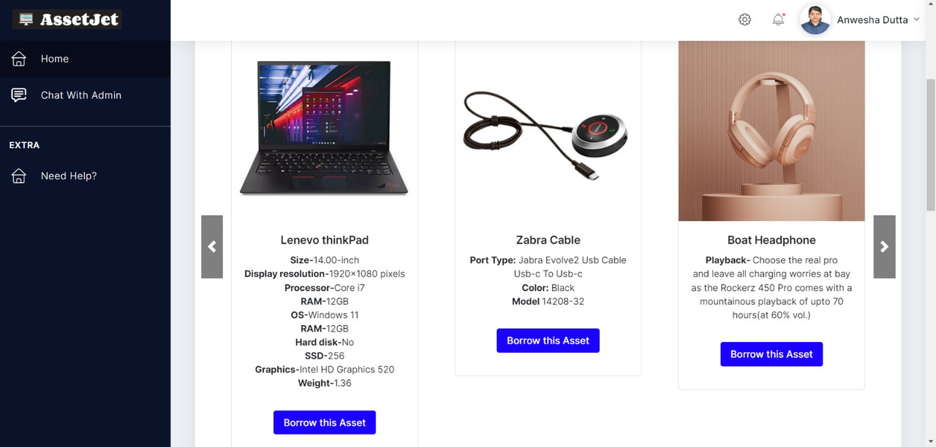
User's Portal

Slide 18
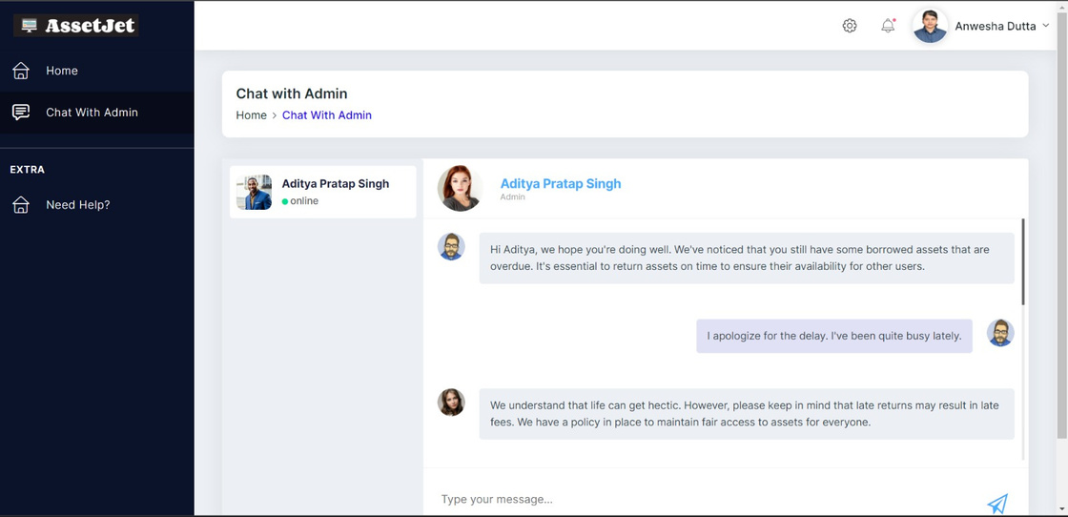
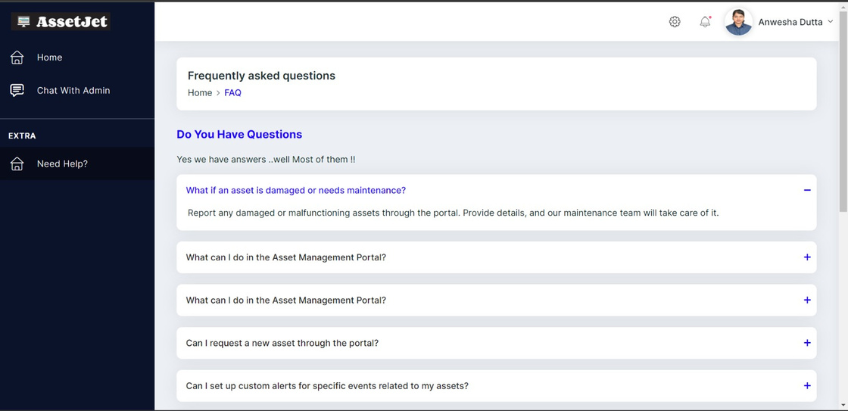
Chat With Admin
FAQs

Slide 19


Future Scope
Machine learning can also enhance anomaly detection for security purposes.
Expand Asset Types: Continuously expand the system's capability to accommodate various asset types.
Feedback Mechanism: Create a feedback loop for users to suggest improvements and enhancements, driving continuous development.

Slide 20
Thank you!

